Slide 1




NATIONAL SCIENCE EXHIBITION

Slide 2
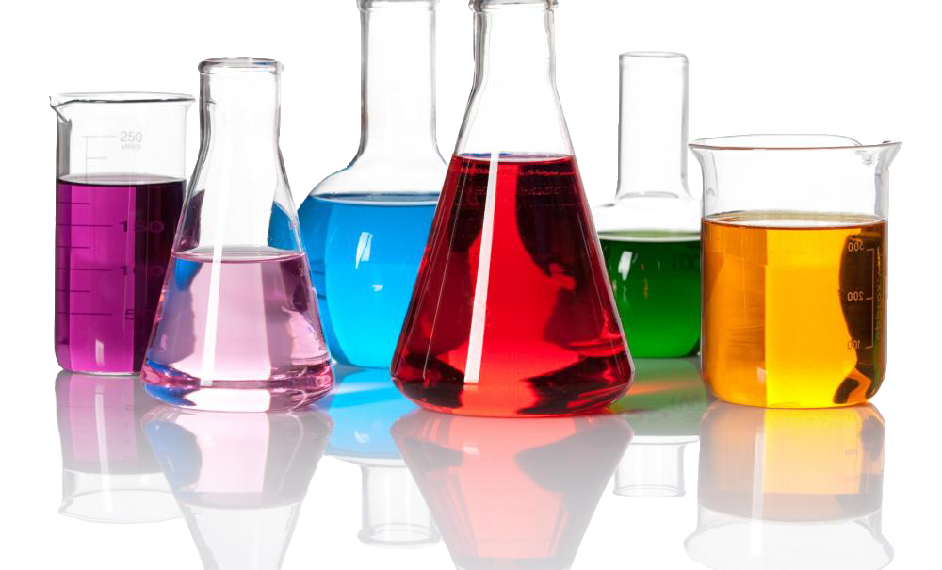
Solution
Created By Ankit kumar jha
guided by Mrs.Neelima Shingh

Slide 3

What is important in this project
It gives user as power to control the teaching process
As user have summary of the chapter to revise .
User can able to check her performance of test by seeing her report like Total question That Answered, Total right answer, Total ,wrong answer, Total skipped question , Marks, Percentage of marks , Accuracy, Time taken, Average number of question in one minute
If user repeat the test he should get different set of question as compare to previous set(all times user will get different set of question)
As if he find hard to solve question of test user can exit from test at any level
If user is practicing for jee it have jee question also

Slide 4
Futures of my program
Teach all topic of chapter solution in sequences same as given in NCERT.
Graph and animation is also used
All chapter is teacher by speech (Voice) and in written mode also
User can able to stop chapter at end of any topic. But when topic is running user cannot able to stop chapter
A extra topic is also given in the teaching series of topics

Slide 5
Features of test
It has summary also in text and voice mode
There is 3 level of test contain question of solution chapter and a extra level having question of solution chapter from previous jee mains question paper
User can able to end test after ending of any level
when user complete it full test;

Slide 6
All wrong answered question or skipped question answer is given only
All level test included jee mains level contain 10 random question and user can able to skip any question
Each right question give 4 +ve marks and a wrong question give 1 -ve marks and no marks is given for skipped question

Slide 7
User can able to hear any question by writing s
At end of test It give all report of all level and a report about user overall performance like . Total question That Answered, Total right answer, Total ,wrong answer, Total skipped question , Marks, Percentage of marks , Accuracy, Time taken, Average number of question in one minute

Slide 8
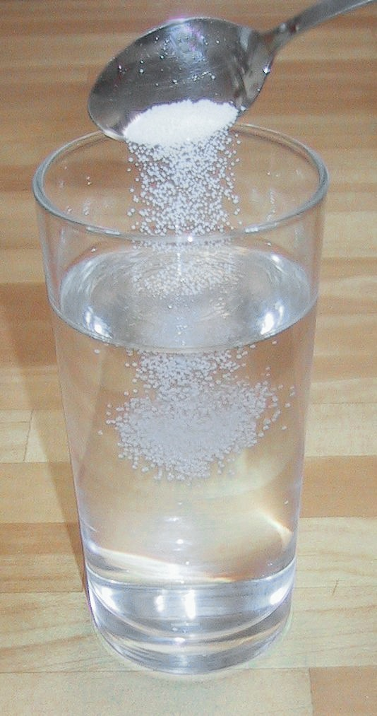
Importance of Solution
Solution is very important in the study of foods and human nutrition. Only substances which can be dissolved can be assimilated. Many substances which will not dissolve in pure water will dissolve in water which contains something else in solution. The blood is water containing many things in solution. The salts of the blood keep the other food elements in solution, many of which would not dissolve if the blood did not contain these salts. The chief work of the digestive juices is to reduce foods to a soluble form so that they can be taken into the circulation by absorption; otherwise they would pass through the alimentary canal practically unchanged.
We must learn to distinguish carefully between chemical solution and merely mixing things with water. A good example is milk. In addition to water, milk contains principally fat, sugar, and casein. The sugar is truly dissolved in the water. The fat and the casein are fine particles held in suspension. If the milk stands for a while, the fat particles rise to the top as cream. If it stands long enough, the casein particles adhere to each other and settle to the bottom, leaving the water with the dissolved sugar or whey in the middle.
Milk as an example of both "Solution" and "Mixture".

Slide 9
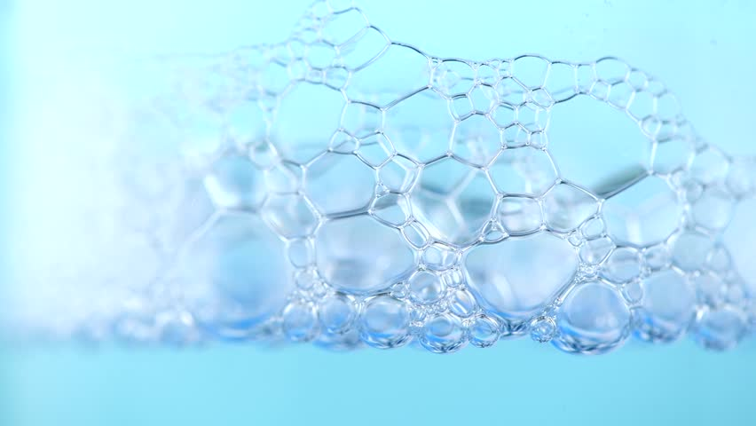
Use of solution In Homes
Water as a solvent is used for drinking ,cooking ,washing, bathing, cleaning and dissolving detergents.
Household cleaning like bleach are solution ,they help us to make our house clean. Beverages such as fizzy drinks ,mineral water and tea are solution.

Slide 10
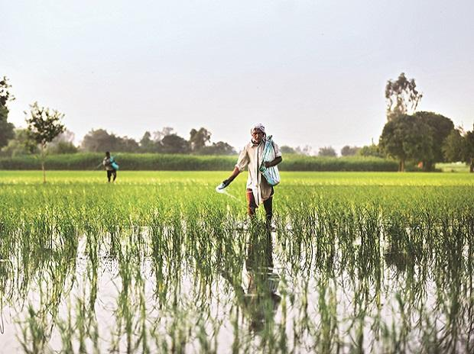
Use of solution In Agriculture
Water as a solvent is used in pesticides and herbicides to dissolve the mineral salt and fertilizers so that plants can absorb them quickly.
In hydroponics, the root of plant are immersed in solution containing dissolved mineral salt.

Slide 11

Use of solution In Medicines
A mixture of different medicines may be needed to treat a disease, however we cannot mix them directly so we need a solvent such as water to combine them
Medicines are mostly bitter ,the ones for children are made sweet by adding sugar solution in them. Ex. tandegyl

Slide 12
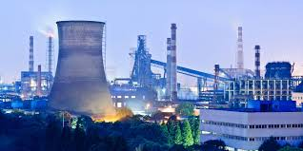
Use of solution In Industries
Turpentine as solvent are used in the production of paints ,inks and dyes .water as a solvent is used in the making of food ,textiles ,soap ,and detergents
Alloys are solid solution that are used in the manufacture of cars ,aerospace and other vehicles.

Slide 13
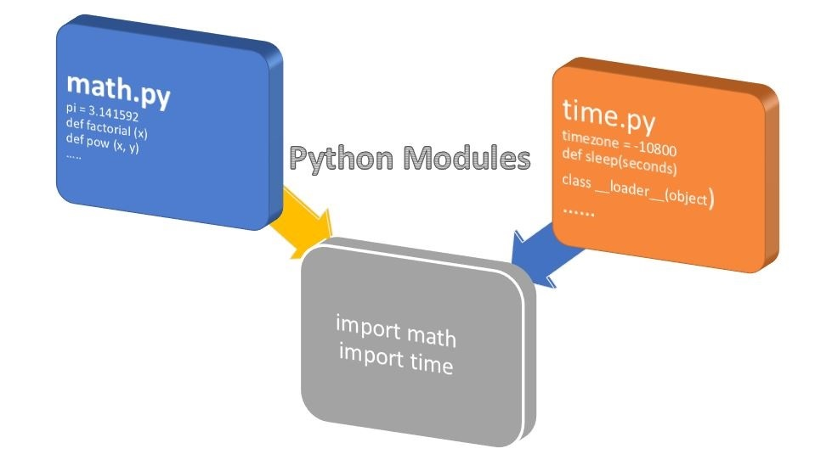
Python module used in programm
Matplotlib
Pygame
Random
Os
Pyttsx3
Pickle
Time
Math

Slide 14

File created
Start Programm.py #Main programm
chemistry_use.py
Chemistry12Funtion.py
main_funtion.py
Question1.py
SolutionLevel1Question.dat
SolutionLevel2Question.dat
SolutionLevel3Question.dat
SolutionLevelMAINSQuestion.dat

Slide 15
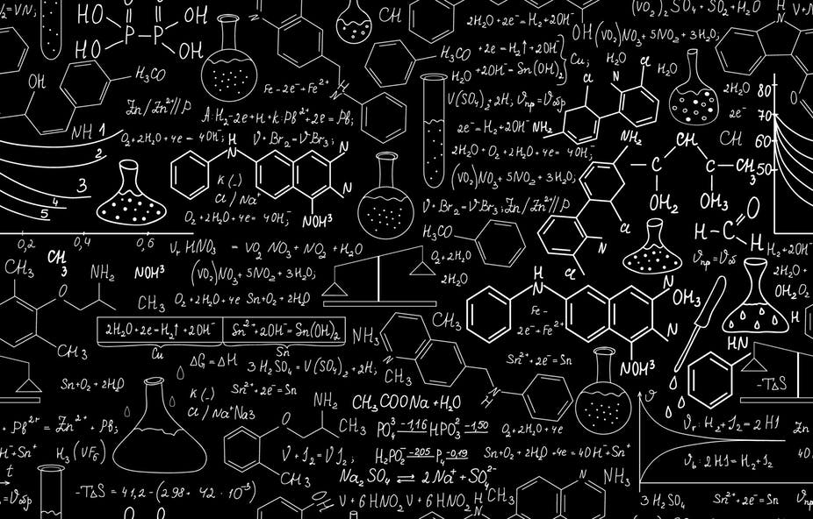
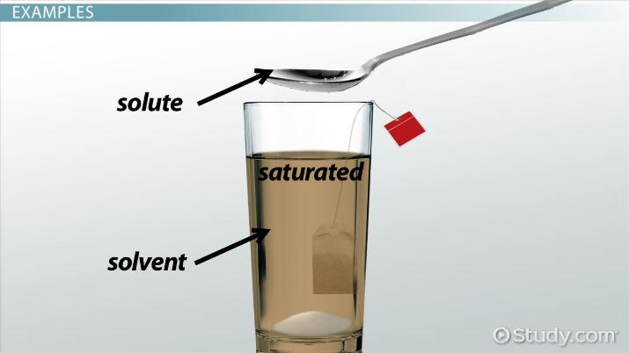

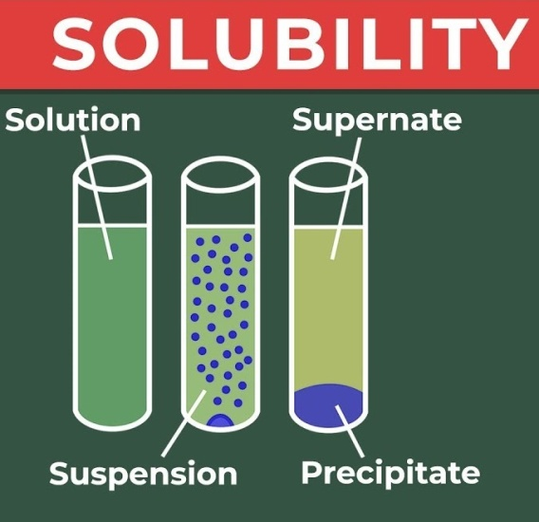
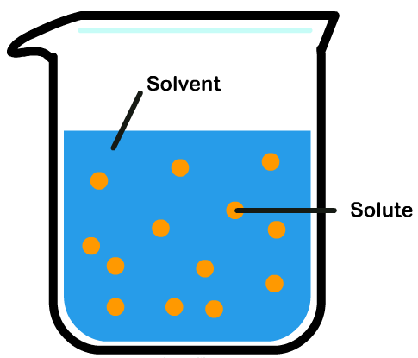
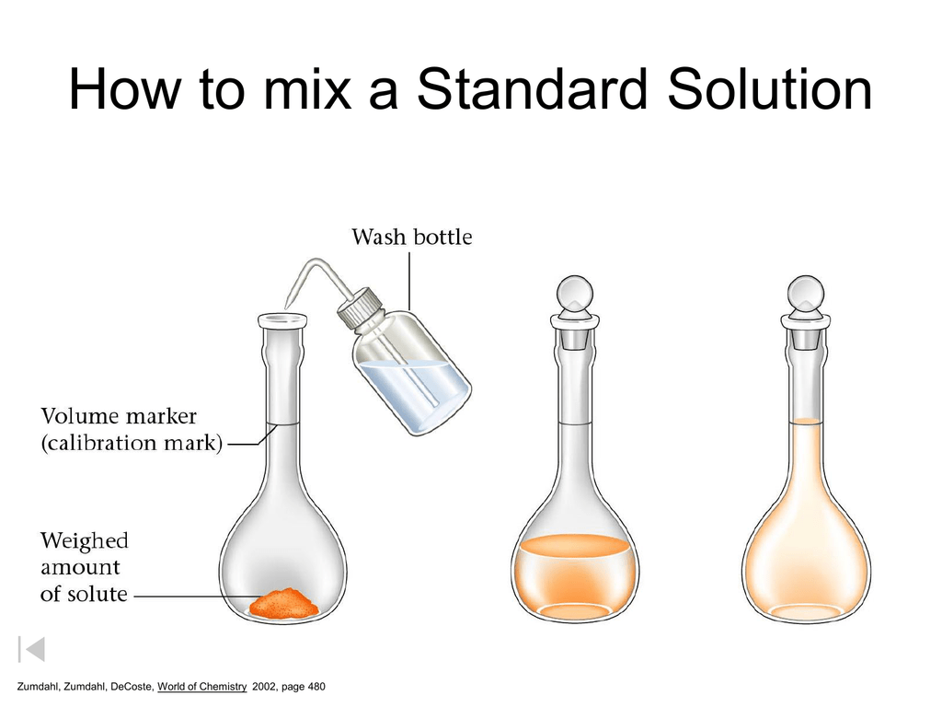

The End

